Slide 1
Grande Omega Tips

Slide 2
General usage
For installation and general usage see the document “GrandeOmega guide - desktop version.pdf” on N@tschool (lms.hr.nl)
This presentation only covers some extra tips that may be of use to you

Slide 3
GO general tips

Slide 4
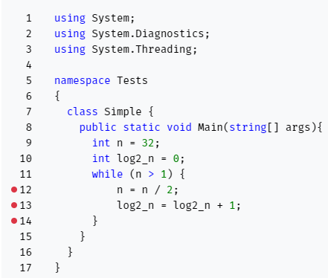
Break points
The red dots beside the numbers in Grande Omega are break points
A breakpoint is where your program pauses (has a break) before continuing

Slide 5
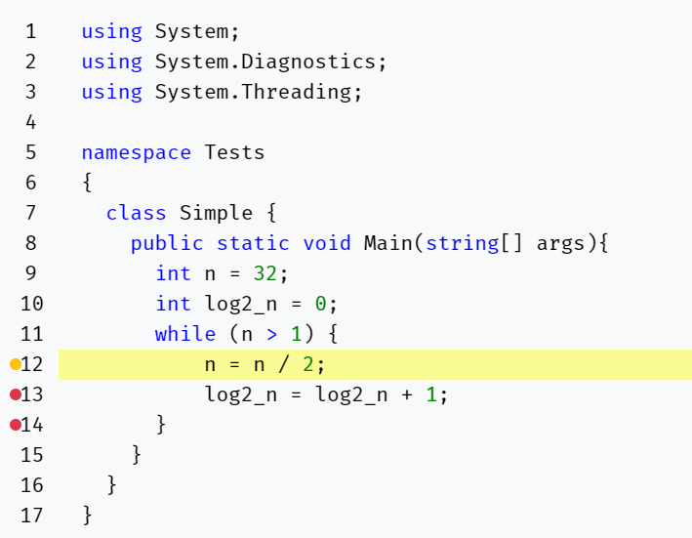
Break points
When the breakpoint is yellow and the line is highlighted yellow it means that the code on that line is just about to be run (executed) - it has not been run yet

Slide 6
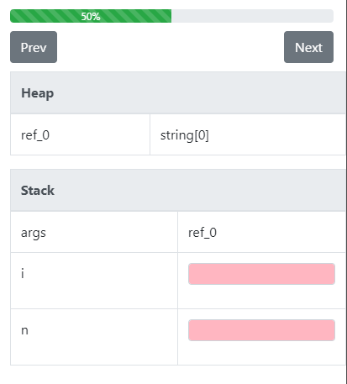
Program Flow
In FAs you can use the progress bar to remind you how far through the program you are
The previous and next buttons can be used to navigate through the program

Slide 7
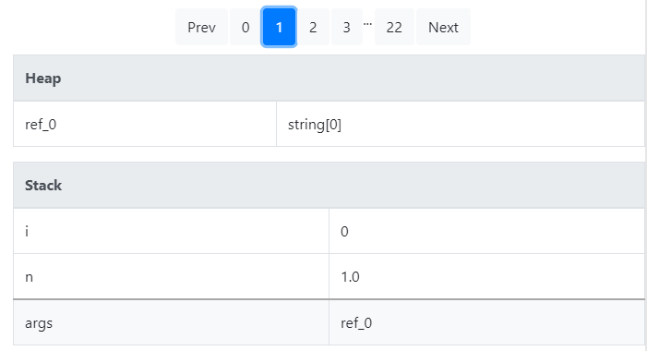
Program Flow
In BAs you can use the numbers at the top of the state to remind you how far through the program you are
The previous and next buttons can be used to navigate through the program

Slide 8
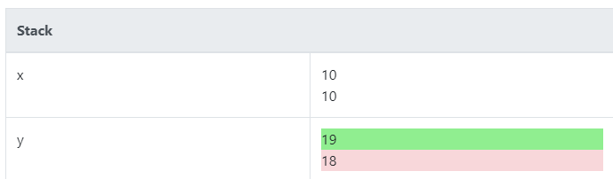
Wrong answers
When you get a question wrong you can sometimes see where you went wrong by looking at the state
Green is the expected answer and red is the actual answer output from your program.
If you would not like to see this feedback any longer and concentrate on the correct output only, you can click on another question and click back on the question you were working on

Slide 9

Resetting the question
The reset button can be used to remove the answers from the question (For BA and FA)

Slide 10

Infinite Loops
When working on questions with loops, if after you click validate the program seems to hang then you probably have an infinite loop
If this happens, click the Cancel validation button
After some time the state will return

Slide 11
Input

Slide 12

Indication of spaces
In BAs do not mistake spaces for underscores
This symbol is just there to indicate that there is a space

Slide 13

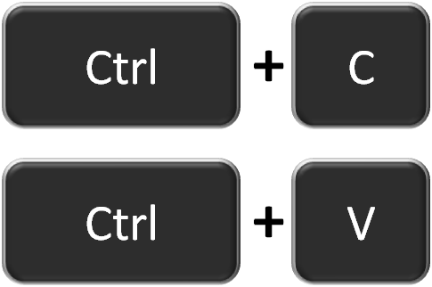
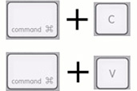
Contents of a string
Unsure what the contents of a string are? You can copy and paste in GO
Windows Mac
Copy
Paste

Slide 14
Moving between input boxes
In FAs and BAs you can tab between input boxes

Slide 15


No need to use all answer boxes
In the BAs you do not need to use all the horizontal answer boxes, both the following examples are accepted:

Slide 16

Answer boxes can have multiple lines (but not always…)
In the BAs it is possible to write multiple lines of code in an answer box

Slide 17
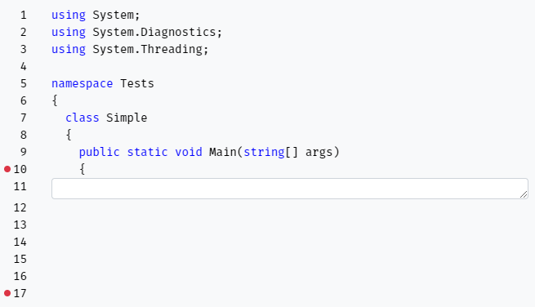
Answer boxes can have multiple lines (but not always…)
In this case the long input box (line 11) indicates that you may fill in more than one line.
However, the number of lines is limited to the line number associated with the next instruction, next input box, or if there is no instruction or input box, then the end of the program (in this case line number 17).
In this example, since the input box begins on line 11 and the end of the program is at line 17, you can input a maximum of 7 lines of code.

Slide 18
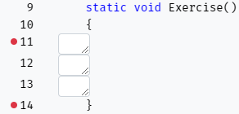
Answer boxes can have multiple lines (but not always…)
In this example you can see that three lines of code are needed to solve this question (11, 12 and 13).
Each box may contain up to one line of code.

